Slide 1
SWITCHING and Topologies

Slide 2

CATEGORIES

Slide 3
CATEGORIES
A one-to-one communication between devices in a large network is infeasible using some topologies such as star, mesh, etc.
A better solution is switching. A switched network consists of a series of interlinked nodes, called switches.
Switches are devices capable of creating temporary connections between two or more devices linked to the switch.
In a switched network, some of these nodes are connected to the end systems and others for routing.
Of these message-switching has been phased out in general communications but is still used in some applications like electronic mail.
In message switching, each switch stores the whole message and forwards it to the next switch.

Slide 4

CIRCUIT-SWITCHED NETWORKS

Slide 5
CIRCUIT-SWITCHED NETWORKS
A circuit-switched network consists of a set of switches connected by physical links.
A connection between two stations is a dedicated path made of one or more links.
However, each connection uses only one dedicated channel on each link.
Each link is normally divided into n channels by using FDM or TDM.
The end systems such as computers or telephones are directly connected to a switch.
3 important phases to connect and transfer the information:
Set up phase , Data transfer phase and Tear down phase.

Slide 6
When end system A needs to communicate with end system M, system A needs to request a connection to M that must be accepted by all switches as well as by M itself.
This is called the setup phase; a circuit (channel) is reserved on each link, and the combination of circuits or channels defines the dedicated path.
Once the dedicated path is established, data transfer takes place. After all data have been transferred, the circuit is teardown.

Slide 7
CIRCUIT-SWITCHED NETWORKS
Setup Phase
Before the two parties (or multiple parties in a conference call) can communicate, a dedicated circuit (combination of channels in links) needs to be established.
The end systems are normally connected through dedicated lines to the switches, so connection setup means creating dedicated channels between the switches.
The resources, such as channels (bandwidth in FDM and time slots in TDM), switch buffers, switch processing time, and switch I/O ports, must be reserved until the teardown phase.
For example as shown in figure, when system A needs to connect to system M, it sends a setup request that includes the address of system M, to switch I.
Switch I finds a channel between itself and switch IV that can be dedicated for this purpose.

Slide 8
Switch I then sends the request to switch IV, which finds a dedicated channel between itself and switch III.
Switch III informs system M of system A's intention at this time.
In the next step to making a connection, an acknowledgment from system M needs to be sent in the opposite direction to system A.
Only after system A receives this acknowledgment the connection is established.
An end-to-end addressing is required for creating a connection between the two end systems. It could be addresses of the computers in a TDM network, or telephone numbers in an FDM network

Slide 9
Data Transfer Phase
After the establishment of the dedicated circuit (channels), the two parties can transfer data.
There is no addressing involved during data transfer. The switches route the data based on their occupied band (FDM) or time slot (TDM).
Data transferred between the two stations is a continuous flow of signal, may be with periods of silence.
Teardown Phase
When one of the parties needs to disconnect, a signal is sent to each switch to release the resources.

Slide 10

CIRCUIT-SWITCHED NETWORKS

Slide 11
CIRCUIT-SWITCHED NETWORKS
Efficiency
The circuit-switched networks are not as efficient as the other two types of networks because resources are allocated during the entire duration of the connection.
These resources are unavailable to other systems.
In a telephone network, people normally terminate the communication when they have finished their conversation.
However, in computer networks, a computer can be connected to another computer even if there is no activity for a long time

Slide 12
Delay
Although a circuit-switched network normally has low efficiency, the delay in this type of network is minimal.
During data transfer the data are not delayed at each switch since the resources are allocated for the duration of the connection.
The total delay is due to the time needed to create the connection, transfer data, and disconnect the circuit.
The delay caused by the setup is the sum of four parts: the propagation time of the source computer request, the request signal transfer time, the propagation time of the acknowledgment from the destination computer, and the signal transfer time of the acknowledgment.
The delay due to data transfer is the sum of two parts: the propagation time and data transfer time. The third one is the time needed to tear down the circuit.
If the receiver requests disconnection, then it causes the maximum delay.

Slide 13

PACKET-SWITCHED NETWORK

Slide 14
PACKET-SWITCHED NETWORK
DATAGRAM NETWORKS
DATAGRAM NETWORKS
In the above figure, all four packets (or datagram's) belong to the same message, but may travel different paths to reach their destination.
This approach can cause the datagram's of a transmission to arrive at their destination out of order with different delays between the packets.
Packets may also be lost or dropped because of a lack of resources.
In most protocols, it is the responsibility of an upper-layer protocol to reorder the datagram's or ask for lost datagram's before passing them on to the application.
The datagram networks are referred to as connectionless networks.
The term connectionless means that the switch does not keep information about the connection state.
There are no setup or teardown phases. Each packet is treated the same by a switch.
In a packet-switched network, the message is divided into packets of fixed or variable size.
The size of the packet is determined by the network and the governing protocol.
In packet switching, there is no resource allocation for a packet.
Therefore, there is no reserved bandwidth on the links, and no scheduled processing time.
Resources are allocated on demand.
The allocation is done on a first-come, first-served basis.
When a switch receives a packet, no matter what is the source or destination, the packet must wait if there are other packets being processed. The lack of reservation creates delay.
In a datagram network, each packet is treated independently of all others regardless of its source or destination. Datagram switching is normally done at the network layer.

Slide 15
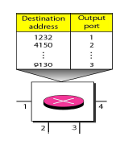
PACKET-SWITCHED NETWORK DATAGRAM NETWORKS

Slide 16
PACKET-SWITCHED NETWORK DATAGRAM NETWORKS
Routing Table
In datagram network, packets are routed to their destinations by means of a routing table.
Each switch (or packet switch) has a routing table which is based on the destination address.
The routing tables are dynamic and are updated periodically.
The destination addresses and the corresponding forwarding output ports are recorded in the tables as shown in the figure.
Every packet in a datagram network carries a header that contains, among other information, the destination address of the packet that remains the same in its journey.
When the switch receives the packet, destination address is examined and the routing table is consulted to find the corresponding port through which the packet should be forwarded.

Slide 17
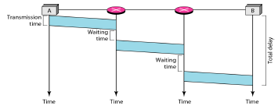
PACKET-SWITCHED NETWORK DATAGRAM NETWORKS

Slide 18
PACKET-SWITCHED NETWORK DATAGRAM NETWORKS
Efficiency
The efficiency of a datagram network is better than that of a circuit-switched network; resources are allocated only when there are packets to be transferred.
The resources can be reallocated if it's idle, for other packets
Delay
Each packet may experience a wait at a switch before it is forwarded. In addition, since not all packets in a message necessarily travel through the same switches, the delay is not uniform for the packets of a message.
In the above figure, the packet travels through two switches.
There are three transmission times (3T), three propagation delays (3t), and two waiting times (W1 + W2).
The total delay is 3T + 3t + W1 + W2

Slide 19
PACKET-SWITCHED NETWORK VIRTUAL-CIRCUIT NETWORKS
A virtual-circuit network is a hybrid of a circuit-switched and datagram network. Some of its characteristics are:
1. As in a circuit-switched network, there are setup and teardown phases in addition to the data transfer phase.
2. Resources can be allocated, as in a circuit-switched network, on demand, but not dedicated, as it shared with other traffic in a datagram network.
3. As in a datagram network, data are packetized and each packet carries an address in the header. However, the address in the header defines what should be the next switch and the channel on which the packet is being carried, not end-to-end.
4. As in circuit-switched network, all packets follow the same path established during the connection.
5. A virtual-circuit network is normally implemented in the data link layer.

Slide 20
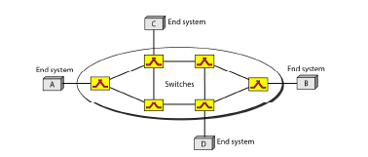
PACKET-SWITCHED NETWORK VIRTUAL-CIRCUIT NETWORKS
The network has switches that allow traffic from sources to destinations.
A source or destination can be a computer, packet switch, bridge, or any other device that connects other networks

Slide 21

Virtual Circuit Network
Three Phases of virtual circuit network:
  Setup, Data Transfer, Teardown
No buffering, less header overhead, resource sharing
Data Transfer in a VCN is shown in below diagram.
2.<number>

Slide 22
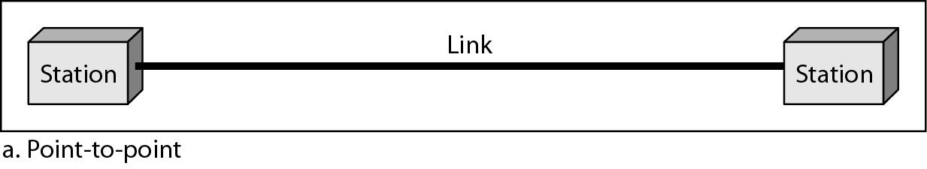
Connection Types
Point-to-Point
A point-to-point connection provides a dedicated link between two devices.
The entire capacity of the link is reserved for transmission between those two devices.
Most point-to-point connections use cable but microwave or satellite links are also possible.
For example a point-to-point connection exists between the remote control and the television's control system.

Slide 23
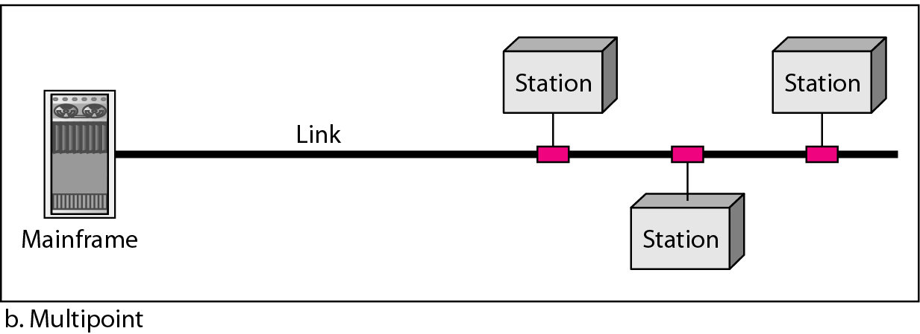
Connection Types
Multipoint
A multipoint connection is one in which more than two devices share a single link.
In a multipoint environment, the capacity of the channel is shared.
If several devices can use the link simultaneously, it is a spatially shared connection.
If users take turns, it is a timeshared connection.

Slide 24

Categories of topology
1.<number>
Notes:
1.#

Slide 25
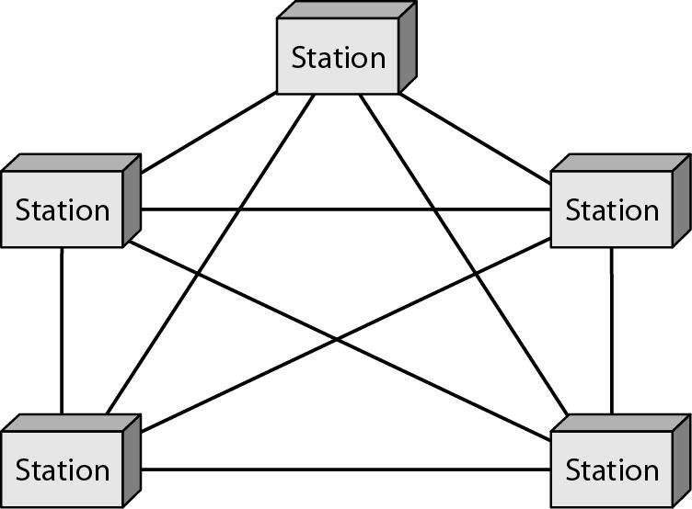
MESH TOPOLOGY
Each device has a dedicated point-to-point link to every other device.
The term dedicated means that the link carries traffic only between the two devices it connects.
A mesh network with n nodes has n(n-1) links [ n(n-1) / 2 in case of duplex ].

Slide 26
MESH TOPOLOGY
The advantages of mesh over other network topologies are:
  The use of dedicated links eliminates traffic problems that occur when link is shared.
  A mesh topology is robust. If one link becomes unusable, it does not incapacitate the entire system.
  Privacy or security is maintained.

Slide 27
MESH TOPOLOGY
The main disadvantages of a mesh are:
  Installation and reconnection are difficult.
  The sheer bulk of the wiring can be greater than the available space.
  The hardware required to connect each link (I/O ports & cable) is expensive.
Due to its major disadvantages, mesh topology is usually implemented in a limited fashion.
An example of a mesh topology
  It is the connection of telephone regional offices in which each regional office needs to be connected to every other regional office.

Slide 28

STAR TOPOLOGY
Each device has a dedicated point-to-point link only to a central controller, usually called a hub.
The devices are not directly linked to one another.
Unlike mesh, a star topology does not allow direct traffic between devices.
The controller acts as an exchange.
If one device wants to send data to another, it sends the data to the controller, which then relays the data to the other connected device.
It is used in LANs.

Slide 29
STAR TOPOLOGY
The advantages :
A star topology is less expensive than a mesh topology.
In a star, each device needs only one link and one I/O port to connect it to any number of others.
This factor also makes it easy to install and reconfigure.
Far less cabling needs to be housed, and additions, moves, and deletions involve only one connection: between that device and the hub.
Star topology is also robust i.e., when one link fails, only that link is affected.
All other links remain active.
As long as the hub is working, it can be used to monitor link problems and bypass defective links.
Disadvantage :
star topology is the dependency of the whole topology on one single point, the hub.
If the hub goes down, the whole system is dead.

Slide 30

BUS TOPOLOGY
Unlike mesh or ring, it is multipoint.
One long cable acts as a backbone to link all the devices in a network.
Nodes are connected to the bus cable by drop lines and taps.
A drop line is a connection running between the device and the main cable.
A tap is a connector that either splices or punctures into the main cable to create a contact with the metallic core.
As signal travels along the backbone, some of its energy is transformed into heat.
Therefore, it becomes weaker and weaker as it travels farther and farther.
For this reason there is a limit on the number of taps a bus can support and distance between the taps.

Slide 31
BUS TOPOLOGY
Advantages of a bus topology include:
Ease of installation.
Backbone cable can be laid along the most efficient path, then connected to the nodes by drop lines.
In this way, a bus uses less cabling than mesh or star topologies.
Disadvantages are:
Difficult reconnection and fault isolation.
Adding new devices require modification or replacement of the backbone.
Signal reflection at the taps can cause degradation in quality.
In addition, a fault or break in the bus cable stops all transmission.

Slide 32
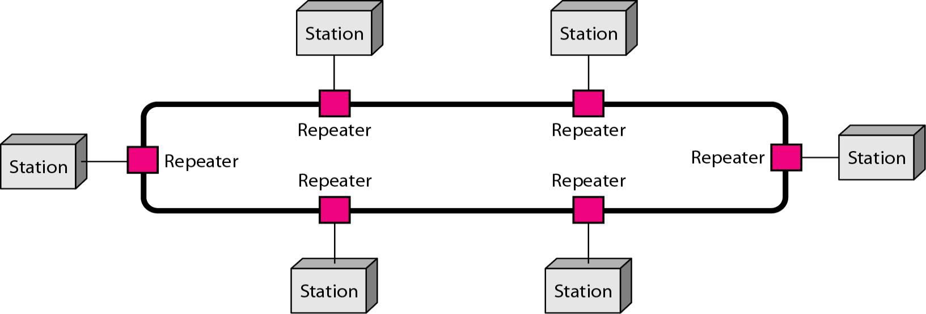
RING TOPOLOGY

Slide 33
RING TOPOLOGY
Each device has a dedicated point-to-point connection with only the two devices on either side of it.
A signal is passed along the ring in one direction, from device to device, until it reaches its destination.
When a device receives a signal intended for another device, its repeater regenerates the bits and passes them along (no drop lines)

Slide 34
RING TOPOLOGY
The advantages are:
Easy to install and reconfigure.
Each device is linked to only its immediate neighbors.
To add or delete a device requires changing only two connections.
Fault isolation is simplified by making a device to issue an alarm if it does not receive a signal within a specified period.
Disadvantages are:
A break in the ring (such as a disabled station) can disable the entire network due to unidirectional traffic (no drop lines)
Ring topology is less popular now.

Slide 35
Network Categories

Slide 36

Local Area Network
A LAN is privately owned and links the devices in a single office, building, or campus.
Depending on the needs of an organization and the type of technology used, a LAN can be simple or extend throughout a company.
Currently, LAN size is limited to a few kilometers.
LANs are designed to allow resources to be shared between personal computers or workstations.
Nowadays, the speed of LAN is in the range 100–1000 Mbps

Slide 37
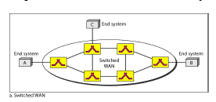
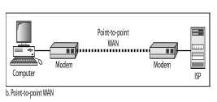
Wide Area Network
A wide area network (WAN) provides long-distance transmission of data, image, audio, and video information over large geographic areas that may comprise a country, a continent, or even the whole world.
A WAN can be either switched or point-to-point.
The switched WAN connects the end systems, comprising a router that connects to another LAN or WAN.
The point-to-point WAN is a line leased from a telephone/cable TV provider that connects a home computer or a small LAN to an Internet service provider (lSP) to provide Internet access.
A good example of a switched WAN is the asynchronous transfer mode (ATM) network.

Slide 38
Metropolitan Area Networks
A MAN is a network with a size between a LAN and a WAN. It normally covers the area inside a town or a city.
It is designed for customers who need a high-speed connectivity to the Internet, and have endpoints spread over a city or part of city.
A good example of a MAN is part of the telephone network providing a high-speed DSL line to the customer.
Internetwork—Nowadays rarely a MAN or LAN exists in isolation; they are connected to one another. When two or more networks are connected, it becomes an internetwork, or internet.

